Slide 1
Mast Cell Activation Disease:
Current Concepts
Sponsored by: Thomas and Judy Kane
Jupiter, Florida
October 13, 2019
Lawrence B. Afrin, M.D.
Hematology/Oncology
Armonk Integrative Medicine
Purchase, NY

Slide 2
Learning Objectives & Disclaimers
Learning Objectives
  Understand basic emerging concepts regarding mast cell biology and disease, particularly:
    Relationships among the various mast cell diseases
    General presentation of mast cell activation syndrome (MCAS)
    General approach to diagnosis and treatment of MCAS
    Also, key issues in nursing care for MCAS patients
Conflicts of Interest
  None

Slide 3
Outline
What is mast cell activation disease (MCAD)?
  What we’ve long known:
    Allergic diseases……………………………………….....
    Mastocytosis………………………………………………..
  What’s new:
    Mast cell activation syndrome (MCAS)…….….
      Basic behavior of the disease
      General approach to diagnosis and treatment
      Key issues in nursing care for MCAS patients
  Research issues
General Clinical Theme
Allergy ± Inflammation
MC Neoplasia ± Allergy
± Inflammation
Inflammation ± Allergy
± Aberrant Growth
(Dystrophism)

Slide 4

Two cases…
Three
“Polycythemia vera”
“Pure red cell aplasia”
and “Burning Mouth Syndrome”?

Slide 5
“Polycythemia vera”
1980s: healthy 30ish woman notices migratory rash
Over time: fatigue, itching, vertigo, falls; evals negative
2005: mildly elevated hemoglobin; polycythemia vera (PV) diagnosed (incorrectly), standard therapy begun
Steadily worsened (migratory GI symptoms, labile BP/
pulse, poor healing, episodic shortness of breath, frequent upper respiratory “infections” with no infectant ever found, rashes to all antibiotics), had to close her business
2008: self-referred for further eval
Afrin LB. Polycythemia from Mast Cell Activation Syndrome: Lessons Learned. Am J Med Sci 2011;342:44-49.

Slide 6
“Polycythemia vera”
No sleep apnea, no relevant family/social/medication history
Exam: looked tired, nothing else
Doesn’t fit PV; what else is driving her issues including ↑hemoglobin?
  Extensive additional testing proves she doesn’t have PV – and fails to find any other known cause of ↑hemoglobin
Possible fit with mastocytosis; is that what it is?
  No?: serum tryptase, urine N-methylhistamine normal; marrow and rash biopsies show no mastocytosis
  Yes?: sl. ↑ urinary prostaglandin D₂
  EGD/colonoscopy: normal, but biopsies taken anyway…
  …all “textbook normal” on H&E, but on IHC…
Afrin LB. Polycythemia from Mast Cell Activation Syndrome: Lessons Learned. Am J Med Sci 2011;342:44-49.

Slide 7
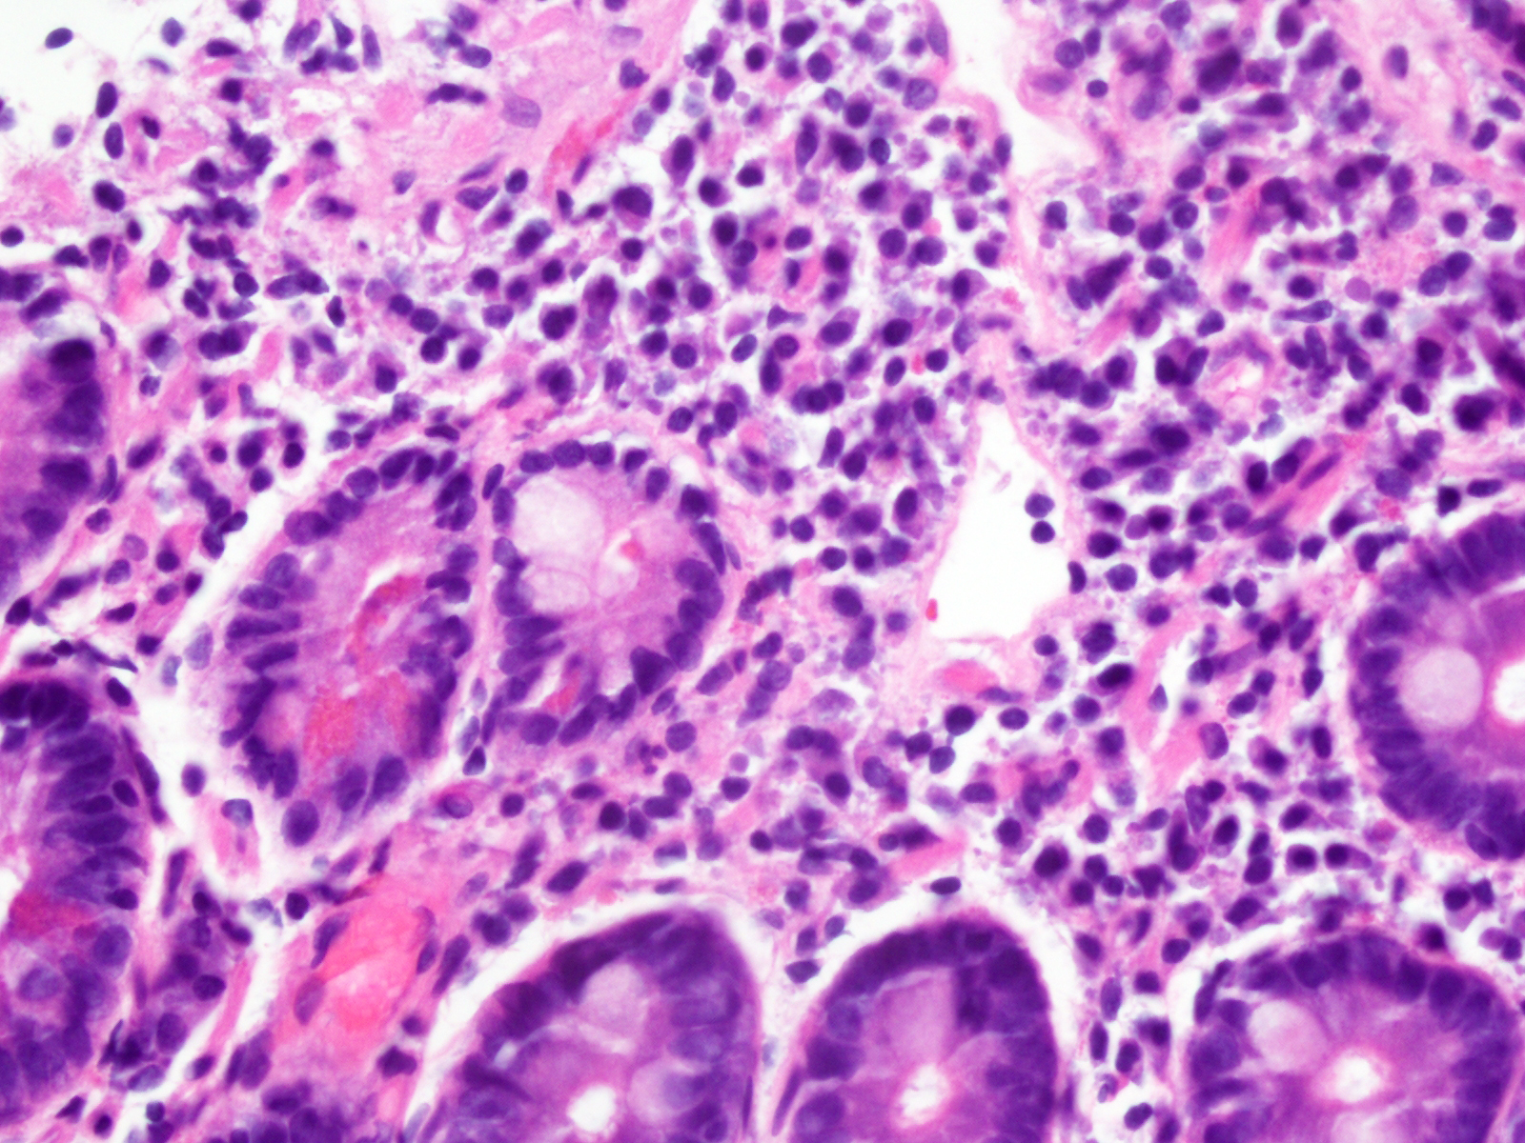
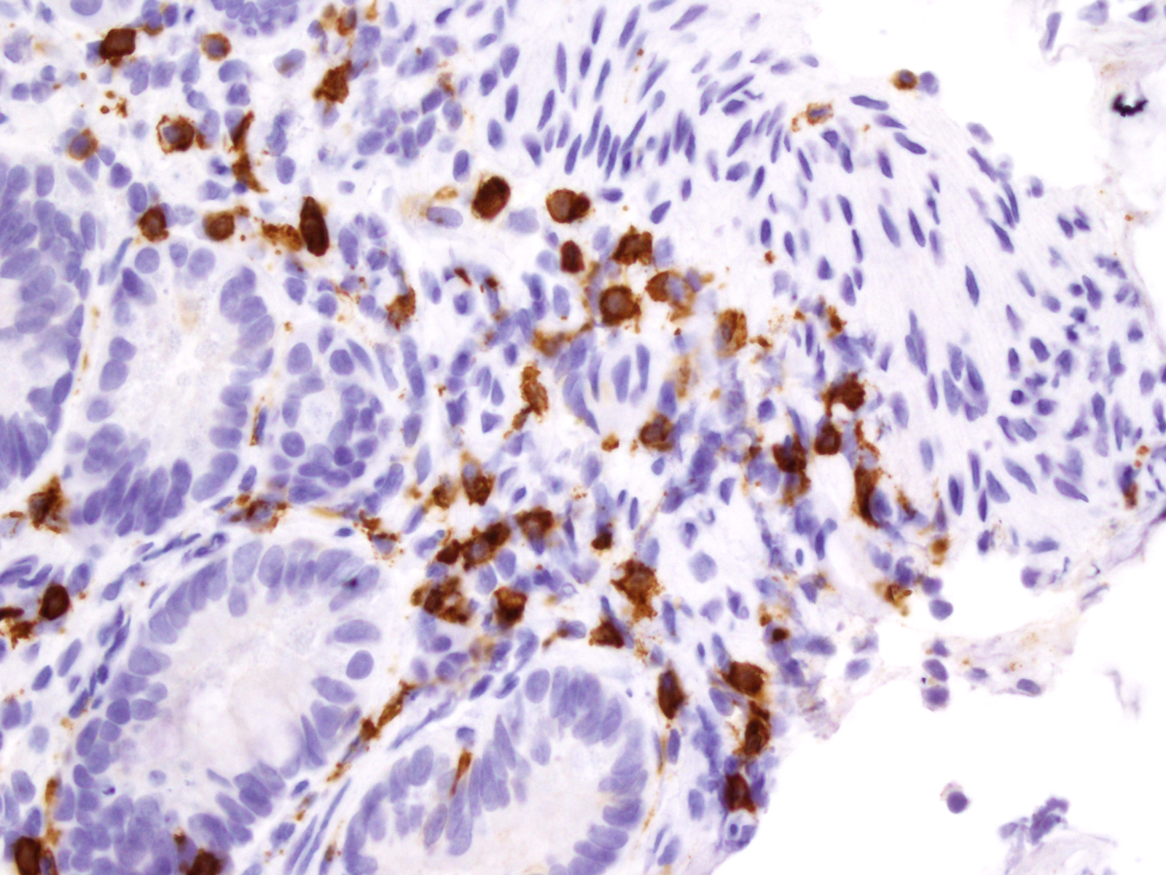
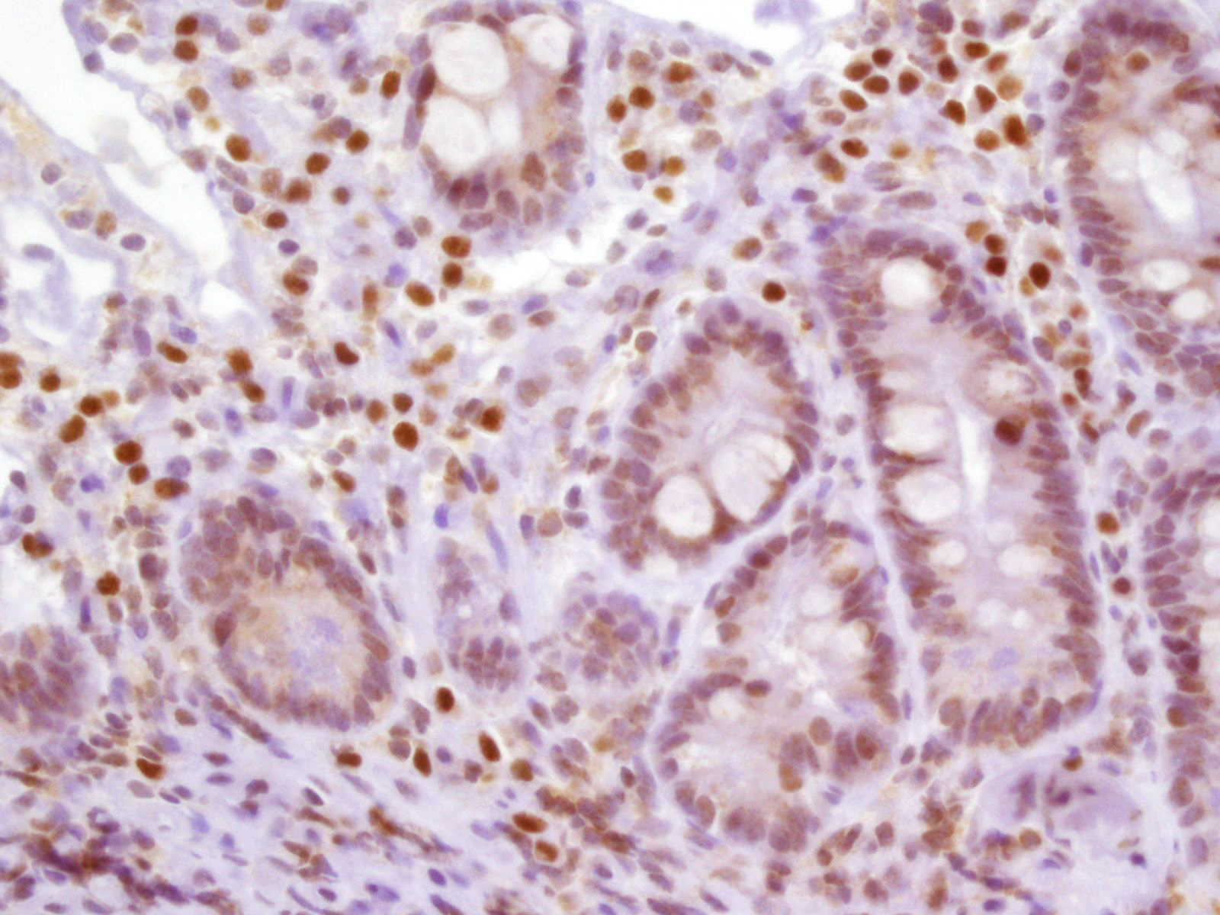
H&E
CD117
40x
Dx: “atypical mastocytosis”?
Low-dose imatinib begun
  100 mg/d x 1 week, then
  200 mg/d
The first week: tolerated fine, but no response
And then, on waking the morning after the fourth dose of 200 mg………..
CD25
40x

Slide 8

“Polycythemia vera”
All symptoms acutely gone.
Improvement sustained >10 years now.
All labs normalized.
Resumed exercise and full-time work.
Afrin LB. Polycythemia from Mast Cell Activation Syndrome: Lessons Learned. Am J Med Sci 2011;342:44-49.

Slide 9
“Pure Red Cell Aplasia”
2004: 50ish woman, worsening fatigue; severe anemia
Dx: idiopathic pure red cell aplasia (PRCA, confirmed)
Refractory to all standard treatments for PRCA
Needing 3 units of blood every 2-3 wks to maintain merely half-normal hemoglobin (Hgb) level
2009: 6th opinion: ROS pan-⊕, uPGD₂ ↑↑↑, Dx: “MCAS”
Antihistamines: Good Hgb ↑ in 4 weeks, no transfusions
Imatinib 200 mg/d added: Hgb normalized in 6 weeks
“PRCA” relapsed 1 yr later
  Tried cromolyn (previously precluded by insurer): remission again in 4 wks
Afrin LB. Pure red cell aplasia masquerading as mast cell activation disorder. Int J Hematol 2010 Jun; 91:907-908.

Slide 10
“Burning Mouth Syndrome”
2004: 50ish woman, new constant “burning” pain throughout GI tract, pain score 10/10 in mouth
Very extensive evaluations over a year all negative except for finding mild chronic stomach inflammation and, finally, a 100-fold elevated serum chromogranin A (CgA) (not on PPIs)
Neuroendocrine (NE) malignancy?
  Miserable from pain, but didn’t look like she had cancer of any sort
  Extensive cancer search negative
  T0p five U.S. NE cancer experts consulted
    Unanimous opinion: ↑↑CgA must be due to NE cancer, keep looking
MC disease?
  Blood/urine markers normal; marrow, oral mucosa biopsies normal
Afrin LB. Burning Mouth Syndrome and Mast Cell Activation Disorder. Oral Surg Oral Med Oral Path Endodontol 2011;111:465-472.

Slide 11
“Burning Mouth Syndrome”
Early ’09: Revisited old gastric biopsy with CD117 staining, showing ↑↑MCs (but not in pattern suggestive of mastocytosis)
Dx: mast cell activation syndrome (MCAS)
Antihistamines/NSAIDs: Pain ↓ to 1/10 overnight
MCAS found in every subsequent “idiopathic” BMS patient I’ve examined
  Different abnormal MC mediator patterns in blood/urine in different patients
  ↑MCs in GI tract biopsies when checked
  All responding to various MC-targeted therapies
Afrin LB. Burning Mouth Syndrome and Mast Cell Activation Disorder. Oral Surg Oral Med Oral Path Endodontol 2011;111(4):465-472.

Slide 12
Highly divergent presentations, but…
…same root disease?
How can “one disease” (MCAS) do this?
Could other “weird” presentations be possible?
But hold on a second. Before talking more about this “new” mast cell disease, let’s back up to look at what we’ve long known about diseases of the mast cell…

Slide 13
Allergic Diseases
Allergy, asthma, angioedema, urticaria, anaphylaxis
2013: 700 million suffer allergic diseases worldwide
  10% of preschoolers worldwide now have food allergies
Steadily increasing incidence/prevalence across all ages
  e.g., China (prevalence): 1999: 3.5%; 2009: 7.7%
  Greatest increases in children < 5 years old
Allergic diseases are conditioned by a number of genes and influenced by environmental factors
  Incidence of allergic disease in children if…
    …neither parent suffers allergic disease: 5-15%
    …only one parent suffers allergic disease: 20-40%
    …both parents suffer allergic disease: ≥ 60%
Relatively little mortality, but significant QoL effects
1. Prescott SL et al. A global survey of changing patterns of food allergy burden in children. World Allergy Organiz J 2013;6:21, pp. 1-12.
2. Pawlinska-Chmara R et al., Effect of Socio-Economic Status on Quality of Life in People Affected with Respiratory Allergy, pp. 385-392, in M. Pokorski (ed.), Neurobiology of Respiration, Advances in Experimental Medicine and Biology 788, DOI 10.1007/978-94-007-6627-3_52, Springer Science+Business Media Dordrecht 2013.

Slide 14
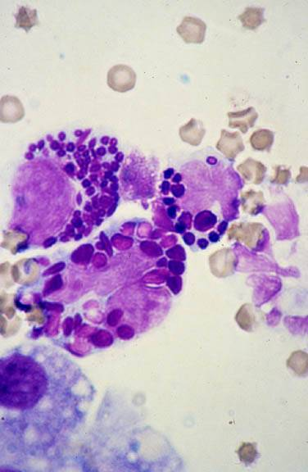
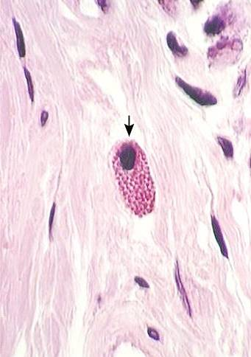
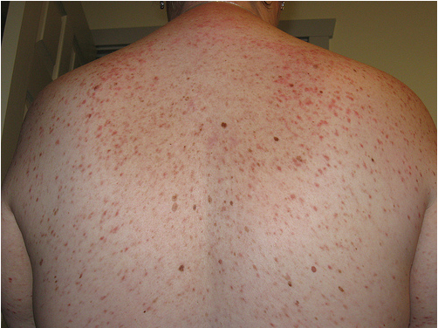
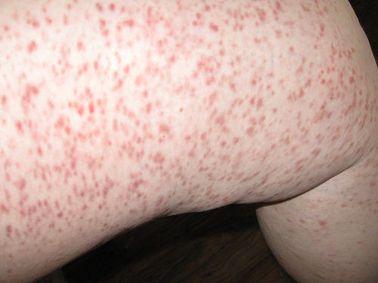
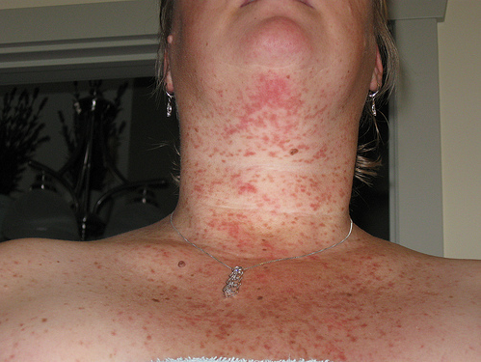
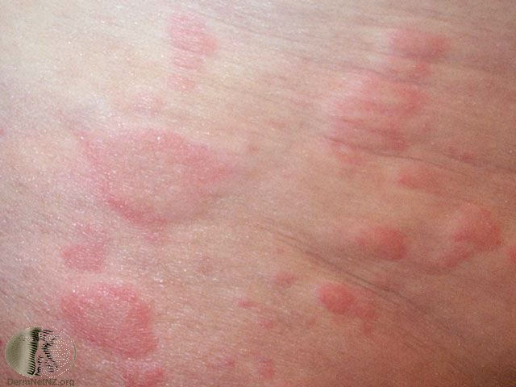
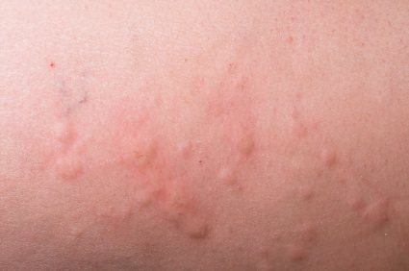
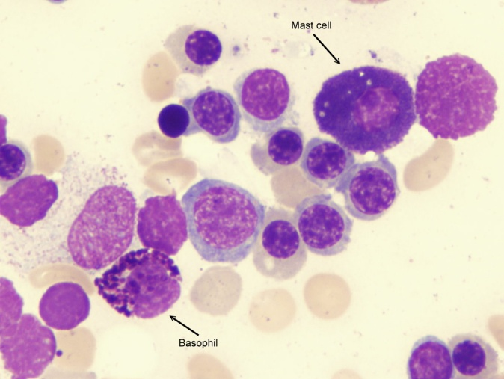
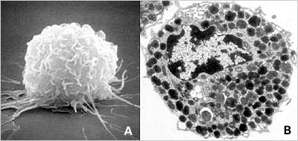
Mastocytosis: A Long History
1869: Urticaria pigmentosa (UP) first described
1877: First description of the mastzelle
1887: UP linked with mastzelles
1933: Suggestion of linkage with internal dz
1939: MC heparin identified
1949: Definitive linkage with systemic dz
1953: MC histamine identified
1987: MC tryptase identified
1988: Travis classification
1988: First conception “MCAS” might exist
1995: KIT activating mutation D816V identified
1998: Unique flow cytometric signature found
  CD117 + (CD25 and/or CD2)
2001: WHO classification and imatinib
MC neoplasia is morbid only in rare, aggressive forms; MC activation is what causes symptoms

Slide 15
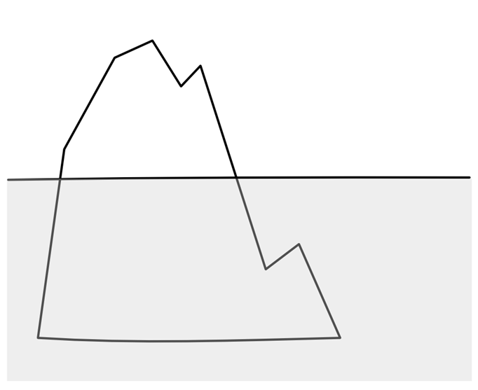
Prevalence of SM: ~1:100,000
Prevalence of MCL: ~1:10,000,000
Mast Cell Leukemia
Prevalence of CM: ~1:10,000
Aggressive Systemic Mastocytosis
Telangiectasia macularis
Systemic mastocytosis with associated
eruptiva perstans
hematologic non-mast-cell-lineage disorder
Mastocytoma
Systemic
Mastocytosis
Smoldering Systemic Mastocytosis
Diffuse Cutaneous
Indolent Systemic Mastocytosis
~70-90% of all SM
Mastocytosis
Disorders also featuring inappropriate mast cell
proliferation
Urticaria
Pigmentosa
Cutaneous
Mastocytosis
Disorders featuring inappropriate mast cell
activation
Prevalence of urticaria:
~1:10
Urticarias and
Angioedema
Allergies and
Anaphylaxis
Prevalence of allergy:
~1:5
Mast Cell
Activation
Syndromes
Not Yet Otherwise Classified
The Spectrum of
Mast Cell Disease
We’ve Long Known

Slide 16
MCAD: A Brief History
1988: 1st published hypothesis that MCAS ought to exist
2007: 1st case reports of MCAS
  Some with KIT-D816V, some without
2007: 1st study showing other KIT mutations in most MCAS (Bonn)
2008-: Non-KIT mast cell regulatory gene mutations found in SM
2010: 2nd study showing KIT mutations in most MCAS (Bonn)
  KIT-D816V rare
  Few mutations in controls
2010: Proposal of “MCAD” (Harvard, Vienna, NIH)
  Includes 1st proposal for MCAS diagnostic criteria
2011: Alternative proposal for MCAS diagnostic criteria (Bonn, MUSC)
  Revised 2016, 2017
2012: Revised (Vienna et al.) proposal for MCAS diagnostic criteria
  Still problematic
  “Updated” again in 2019 – no different than 2012
2016: Revised WHO diagnostic criteria for SM
  Mastocytosis now separate from the myeloproliferative neoplasms (MPNs)
  “Smoldering SM” added; “SM-AHNMD” shortened to “SM-AHN”
  No statement regarding MCAS

Slide 17
MCAD: Emerging Understanding
Mast Cell Leukemia
Aggressive Systemic Mastocytosis
Telangiectasia macularis
Systemic mastocytosis with associated
eruptiva perstans
hematologic non-mast-cell-lineage disorder
Mastocytoma
Systemic
Mastocytosis
Smoldering Systemic Mastocytosis
Diffuse Cutaneous
Indolent Systemic Mastocytosis
Mastocytosis
Disorders also featuring inappropriate mast cell
proliferation
Urticaria
Pigmentosa
Cutaneous
Mastocytosis
Urticarias and
Angioedema
Allergies and
Anaphylaxis
Disorders featuring inappropriate mast cell
activation
Mast Cell
Activation
Syndromes
Not Yet Otherwise Classified
Prevalence ~17%?

Slide 18

Mast Cell Activation Disease
Mast Cell Leukemia
0.0000001%?
Aggressive Systemic Mastocytosis
Increasing prevalence
SM-AHNMD
Indolent Systemic Mastocytosis
Cutaneous Mastocytosis
Mast Cell Activation Syndrome
17%?

Slide 19
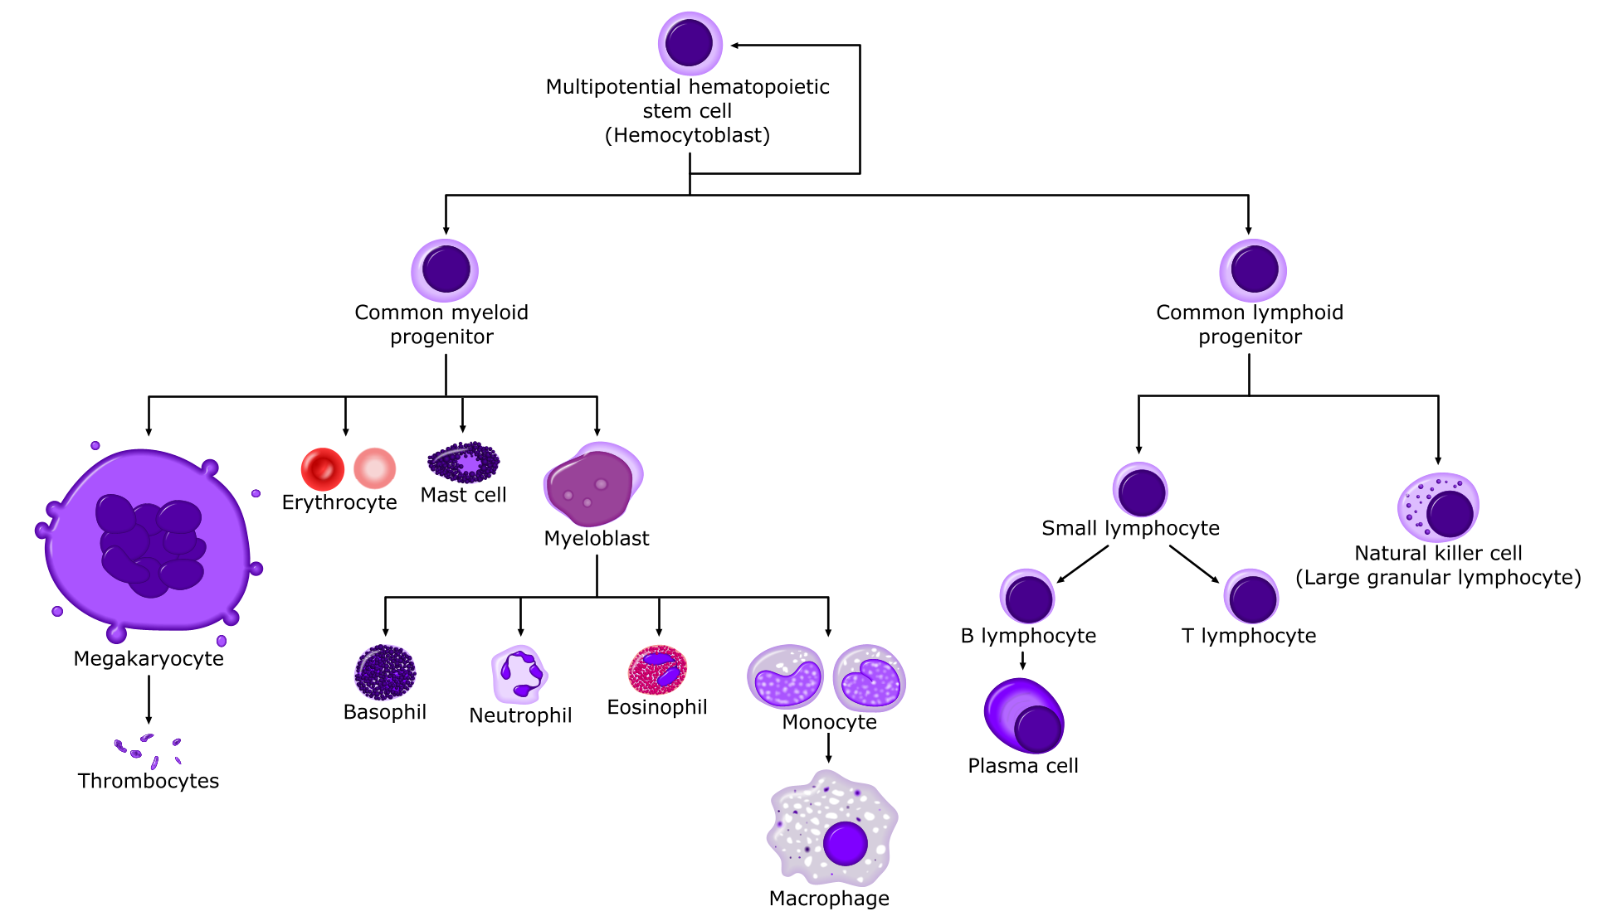
Normal mast cell biology
From allthingsstemcell.com

Slide 20
Normal mast cell biology
Hematopoietic origin, brief circulation
  Normally 0.05% of marrow nucleated cells
  Typically < 2% even in systemic mastocytosis
  Unique flow cytometric signature (incl. CD117+, CD25/2-)
Maturation completed in all vascularized tissues
  Especially abundant beneath environmentally exposed mucosal/epithelial surfaces and adjacent to blood and lymphatic vessels and nerves, permitting sentinel function
Relatively immobile once localized in peripheral tissue
Lifespan typically several months to a few years
Kalesnikoff J, Galli SJ. New developments in mast cell biology. Nature Immunology 2008;9:1215-23.
Ribatti D. The development of human mast cells: an historical reappraisal. Exp Cell Res 2016;342(2):210-5.

Slide 21
Normal mast cell biology
Functions (when appropriately stimulated):
  Synthesize active substances
    Some stored in granules of highly heterogeneous content
  Release various mediators upon various triggerings
  Phagocytose particulate material including bacteria, erythrocytes, schistosomes, metals, etc.
KIT stem cell factor receptor and tyrosine kinase (on 4q11-12) is expressed at high levels on the mastocyte surface
  Critical for many mast cell functions including survival, differentiation, chemotaxis, and activation
Akin C, Metcalfe DD. The biology of Kit in disease and the application of pharmacogenetics. J Allergy Clin Immunol 2004; 114:13–19.
Gordon JR et al. Mast cells as a source of multifunctional cytokines. Immunol Today 1990;11:458.
Bradding P et al. Heterogeneity of human mast cells based on cytokine content. J Immunol 1995; 155:297.

Slide 22
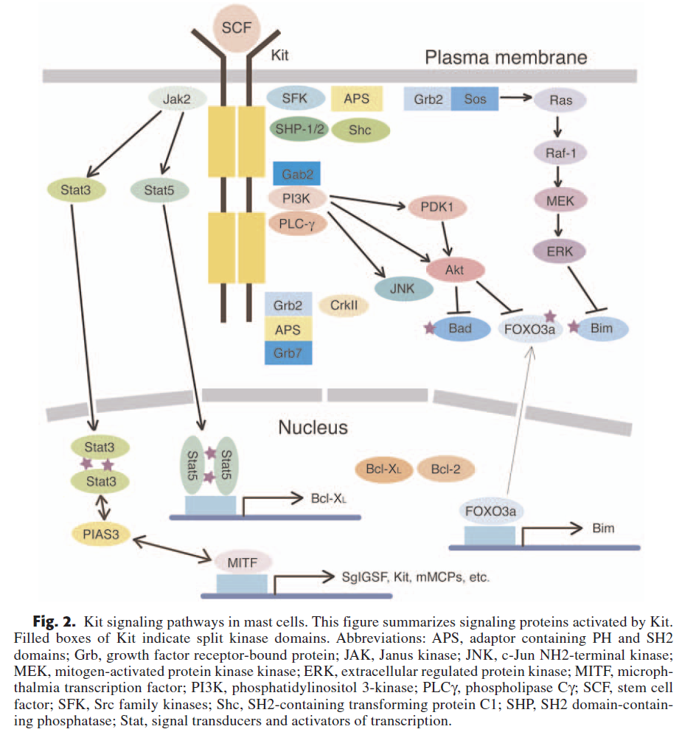
Okayama Y, Kawakami T. Development, migration, and survival of mast cells. Immunologic Research 2006;34(2):97-115.

Slide 23
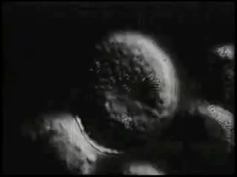
Normal mast cell biology
Many triggers
  Classic: Adjacent high-affinity IgE receptors (FcεRI) with bound IgE get crosslinked by polyvalent antigen
  Physical stimuli: Pressure/trauma, heat, cold, UV, etc.
  Many other receptors for: histamine (H1/H2/H3/H4), SCF, IgG, C3a, C5a, PAF, CRF, neuropeptides (VIP, substance P, somatostatin, etc.), opioids, paralytics, benzodiazepines, cannabinoids, etc. etc. etc.
  Also many of the Toll-like receptors (affinities for various microbial proteins)
Bischoff SC et al. J Exp Med 1992;175:237.
Theoharides TC et al. Trends Pharmacol Sci 2008;29:375–382.
Conrad DH et al. J Immunol 1975;114:1688.
Woolhiser MR et al. Eur J Immunol 2001;31:3298.
Nilsson G et al. J Immunol 1996;157:1693.
Marshall JS et al. Int Arch Allergy Immunol 2003;132:87.
Church MK et al. Int Arch Allergy Appl Immunol 1991;94:310.
Stellato C et al. Anesthesiology 1991;74:1078.
Moss J et al. Anesthesiology 1983;59:330.
Miller LG et al. Pharmacology 1988;36:52–60.
Samson M-T et al. J Immunol 2003;170:4953-4962.
Kajiwara N et al. J Allergy Clin Immunol 2010;125:1137.
Theoharides TC, et al. New Engl J Med 2015;373:163-72.

Slide 24
Normal mast cell biology
Capable of synthesizing and releasing many mediators
  Many expressible at very high levels
  Some stored in fully active form in electron-dense secretory granules, tightly packaged with serglycin proteoglycans
  A small sample:
  Pro-inflammatory cytokines
    IL-1α, IL-1β, IL-2, IL-4, IL-5, IL-6, IL-7, IL-9, IL-10, IL-12, IL-13, IL-15, IL-16, IL-18, IL-21, IL-23, IL-25, IFN-γ, TNF-α
  Chemokines
    MCP-1, IL-8, RANTES, eotaxin, leukotrienes B₄, C₄, D₄, E₄ (SRS-A), CCL2, CCL3, CCL4, CCL5, CCL11, CCL19, CCL20, CCL21, CXCL8, CXCL10, XCL-1
  Proteases
    Tryptase, chymase, ACE, carboxypeptidase, cathepsin G, cysteinyl cathepsins, metalloproteinases
  Growth factors
    IL-3, GM-CSF, bFGF, VEGF, TGF-β, PDGF, EGF, NGF, SCF, angiopoietin
  Vascular permeability, vasodilatation
    Histamine, 5-hydroxytryptamine, tryptase, NO, VLA4
  Platelet aggregation and thrombosis:
    PAF, thromboxane
  Heparin proteoglycan
  Chondroitin sulfate proteoglycan
  Superoxide dismutase
  Acid hydrolases
    Glucuronidase, galactosidase, hexosaminidase, peroxidase
  Arylsulphatase A
  Prostaglandin D₂, thromboxane
  Serotonin
  Antimicrobial agents
    IFN-α, IFN-β, IFN-γ, cathelicidin, LL-37
  CRH
  TSLP
  Want more? See http://www.cells-talk.com/index.php/page/copelibrary?key=mast%20cells
Theoharides TC et al. Differential release of mast cell mediators and the pathogenesis of inflammation. Immunological Reviews 2007;217(1):65-78.

Slide 25
Criteria for Systemic Mastocytosis
  WHO ’16: Indol. SM, smold. SM, SM-AHN, aggressive SM, MC leukemia
  1 major + 1 minor, or 3+ minor criteria
  Only major criterion: “Multifocal, dense infiltrates of mast cells consisting of 15 or more mast cells in aggregates detected in sections of bone marrow and/or other extracutaneous organs, confirmed by tryptase immunohistochemistry or other special stains”
  4 minor criteria:
    More than 25% of MCs in biopsy sections or bone marrow aspirate smears showing spindle shape or atypical morphology
    Expression of CD2 and/or CD25 by marrow, blood, or extracutaneous organs MCs
    KIT codon 816 mutation in bone marrow, blood, or other extracutaneous organs
      Different KIT mutations → different phenotypes
        D816V: MC clusters, spindle forms, expression of CD25, histamine, CPA, etc.
        Extracellular domain: AKT activation
    Serum total tryptase (25% of MC protein!) persistently > 20 ng/ml
Arber DA et al. The 2016 revision to the World Health Organization classification of myeloid neoplasms and acute leukemia. Blood 2016;127:2391-2405.
Mayerhofer M et al. Unique effects of KIT D816V in BaF3 cells: induction of cluster formation, histamine synthesis, and early mast cell differentiation antigens. J Immunol 2008;180:5466-5476.
Teodosio C et al. Mast cells from different molecular and prognostic subtypes of systemic mastocytosis display distinct immunophenotypes. J Allergy Clin Immunol 2010;125:719-726.e4.
Yang Y et al. Pediatric mastocytosis-associated KIT extracellular domain mutations exhibit different functional and signaling properties… Blood 2010 Aug 19, 116(7):1114-1123.
Alvarez-Twose I et al. Clinical, biological, and molecular characteristics of clonal mast cell disorders presenting with systemic mast cell activation symptoms. J Allergy Clin Immunol 2010;125:1269-1278.e2.
Schwartz LB et al. Quantitation of histamine, tryptase, and chymase in dispersed human T and TC mast cells. J Immunol 1987;138(8):2611-2615.

Slide 26

The Problem
Chronic Fatigue Syndrome!
Fibromyalgia!
POTS!
Refractory
GERD!
Just Old
Age!
Granuloma Annulare, or Chronic
Inflammatory Demyelinating
Polyneuropathy, or…or…or…!

Slide 27

What to do when it behaves like mast cell disease but isn’t allergic disease or mastocytosis:
Consider mast cell activation syndrome

Slide 28
Proposed Criteria for MCAS
Self-described “consensus” proposal
  Problem: Methods by which “consensus” was obtained
  History consistent with chronic and/or recurrent aberrant mast cell mediator release
    Problem: Few symptoms listed in proposal (e.g., flushing)
  Not SM and no better-fitting disease
  Rise in tryptase (within 4h of flare) of 20% + 2 ng/ml over asymptomatic baseline
    Problem: establishing “asymptomatic” baseline
    Problem: getting blood for tryptase level drawn within 4h of flare
    Problem: allows levels well within normal range to signify disease
    Problem: no published data whether this distinguishes nl./abnl. fluctuation in the general MCAS population despite repeated assertions otherwise
  Response to mast cell-targeted therapy
    Problem: requires therapy prior to diagnosis
    Problem: should diagnosis of this very heterogeneous disease be ruled out if 1 or 2 lines of empiric therapy fail?
Valent P et al. Definitions, criteria and global classification of mast cell disorders with special reference to mast cell activation syndromes: a consensus proposal. Int Arch Allergy Immunol 2012 Jan;157:215-225.
Akin C et al. Mast cell activation syndrome: proposed diagnostic criteria. J Allergy Clin Immunol 2010; 126:1099-1104.e4.
Valent P et al. Why the 20% + 2 tryptase formula is a diagnostic gold standard for severe mast cell activation and mast cell activation syndrome. Int Arch Allergy Immunol 2019 (e-pub in advance of print), doi: 10.1159/000501079.

Slide 29

Diagnosing MCAS: Criteria
“Molderings et al. 2017” proposal:
  Major criterion:
    Constellation of clinical complaints attributable to pathologically increased MC activity (MC mediator release syndrome)
  Minor criteria:
    Multifocal or disseminated infiltrates of MCs in marrow and/or extracutaneous organ(s) (e.g., gastrointestinal or genitourinary tract; >19 MCs/high power field)
    Abnormal spindle-shaped morphology in >25% of MCs in marrow or other extracutaneous organ(s)
    Abnormal MC expression of CD2 and/or CD25 (i.e., co-expression of CD117/CD25 or CD117/CD2)
    MC genetic changes (e.g., activating KIT codon 419, 509, or 560 mutations) shown to increase MC activity
    Evidence (typically from body fluids such as whole blood, serum, plasma, or urine) of above-normal levels of MC mediators including: tryptase, histamine or its metabolites (e.g., N-methylhistamine), heparin, chromogranin A (note potential confounders of cardiac/renal/hepatic failure, neuroendocrine tumors, chronic atrophic gastritis, or recent proton pump inhibitor use), other relatively MC-specific mediators (e.g., eicosanoids including prostaglandin (PG) D₂, its metabolite 11-β-PGF_{2α}, or leukotriene E4)
    Symptomatic response to inhibitors of MC activation or MC mediator production or action
  Diagnosis made upon fulfillment of the major criterion + ≥ 1 minor criterion…
    …and, of course, no other evident diagnosis which better accounts for the full range and duration of all the symptoms and findings in the history, exam, and labs
New
Expanded
Same as WHO
Same as WHO
Expanded
Expanded
Added
Molderings GJ et al. F1000Res. 2017 Oct 26;6:1889. doi: 10.12688/f1000research.12730.1, updated from Afrin LB, et al. Often seen, rarely recognized: mast cell activation disease – a guide to diagnosis and therapeutic options. Ann Med 2016;48(3):190-201, updated from Molderings G, et al. Mast cell activation disease: a concise practical guide for diagnostic workup and therapeutic options. J Hematol Oncol 2011;4:10.

Slide 30
MCAS: Emerging Understanding
Increasing estimates of prevalence
  1-17% of the general first-world population?
Increasing evidence of critical mast cell involvement in…
If MCAS dominantly manifests as chronic inflammatory disease (CID), might its prevalence be even higher within populations enriched for CID
(e.g., inpatients)?
Est. Global Prev.
Est. Global Prev.
  Asthma (4-20%)
  Obesity (37%)
  Depression (5%)
  Atherosclerosis (?)
  Etc. etc. etc. etc.
  Irritable bowel syndrome (11%)
  Chronic fatigue syndrome (3%)
  Fibromyalgia (1-10%)
  Diabetes mellitus (2-20%)
  Asthma
  Obesity
  Depression
  Atherosclerosis
  Etc. etc. etc. etc.
  Irritable bowel syndrome
  Chronic fatigue syndrome
  Fibromyalgia
  Diabetes mellitus
What Portions of These Populations Bear Clonal Mast Cell Disease?
Theoharides TC. Clin Ther 2013;35:544-7.
Afrin LB. Oral Surg Oral Med Oral Path Oral Radiol Endodontol 2011;111:465-472.
Haenisch B, et al. Immunol 2012;137:197-205.
Pejler G, et al. Blood 2010;115(24):4981-4990.
Theoharides TC, et al. Biochim Biophys Acta 2012 Jan;1822(1):21-33.
Theoharides TC, et al. Trends Pharmacol Sci 2011;32(9):534-542.
Brightling CE, et al. Curr Allergy Asthma Reports 2005;5:130-135.
Blanco I, et al. Clin Rheumatol 2010;29:1403-1412.
Theoharides TC, et al. J Clin Psychopharmacol 2005;25:515-520.
Theoharides TC, et al. J Clin Psychopharmacol 2004;24:577-581.
Molderings GJ, et al. PLoS One 2013;8(9):e76241
Frieling T, et al., Z Gastroenterol 2011;49:191-194.

Slide 31
MCAS: Emerging Biology
May be clonal in most cases…
  More than 50 mutations (mostly heterozygous, but still functionally dominant) found scattered across all domains of KIT
  Most patients have multiple KIT (and other) mutations
  No commercial assays yet for most of these mutations
…but not yet independently confirmed…
…thus issue of “non-clonal” vs. “undetermined clonality”
  Readily available genome/exome sequencing may resolve this soon
Might autoantibodies (e.g., anti-IgE, anti-IgE-receptor) be key drivers/contributors in some cases?
Molderings GJ et al. Multiple novel alterations in Kit tyrosine kinase in patients with gastrointestinally pronounced systemic mast cell activation disorder. Scand J Gastroenterol 2007; 42(9):1045-1053.
Molderings GJ et al. Comparative analysis of mutation of tyrosine kinase Kit in mast cells from patients with systemic mast cell activation syndrome and healthy subjects. Immunogenetics 2010;62:721-727.

Slide 32
MCAS: Emerging Biology
KIT mutations found thus far in MCAS:
    Ligand-binding domain: W8R, C12S, del(nt a153), E53K, insertion 71 ?seq(400bp), E73R, T74R, exon 3 & 5 del and ins/del, ins nt 248a, ins Q252, K259E, H265Q, E270K, L276S
    Dimerization domain: E338K, Q346L, M351E, F355L, E359V, exon 7 ins/del, del (aa 378-390)
    Proteolytic cleavage site: L416Q, D419H, ins(nt 1282g), exon 8 del
    Membrane-spanning region: del 510-513, exon 10 ins, M541L
    Juxtamembrane (autoinhibitory) region: F584C
    Kinase insert sequence K1: S709A, del(S715), A736V, D751Y
    Kinase domain K2: F782S, N787D, H790R, D816V (rare!), S821F, A829T, A837V, L862V
    C-terminus: complex insertions
Molderings GJ et al. Multiple novel alterations in Kit tyrosine kinase in patients with gastrointestinally pronounced systemic mast cell activation disorder. Scand J Gastroenterol 2007; 42(9):1045-1053.
Molderings GJ et al. Comparative analysis of mutation of tyrosine kinase Kit in mast cells from patients with systemic mast cell activation syndrome and healthy subjects. Immunogenetics 2010;62:721-727.

Slide 33




MCAS: Do the Biology Math
MCs produce and release scores of mediators
1 mutation ⇒ aberrant release of N mediators
Multiple KIT mutations in most MCAS patients?
Multiple genes mutated in most MCAS patients?
Each mediator has its own unique array of direct and indirect, local and remote effects

Slide 34
MCAS: Presentation
MCAS is a chronic multisystem polymorbidity of general themes of:
  Inflammation – the universal constant in MCAS
  ± allergic-type phenomena
  ± aberrancies in growth/development (i.e., dystrophisms), far more commonly benign than malignant in potentially any tissue
    can be difficult to recognize given typically slow pace of development and, often, lack of clinical significance
Afrin LB, Butterfield JH, Raithel M, Molderings GJ. Ann Med 2016;48(3):190-201.

Slide 35
MCAS: Presentation
Typical presentation
  Age of onset: typically < 20 but unrecognized for decades
  Usually MULTISYSTEM; can affect every system
  Symptoms often (but not always) “inflammatory”
  Perplexingly inconstant course:
    Abnormalities often externally inapparent (“she looks fine!”)
    Chronic or waxing/waning or episodic (“flares”, “spells”)
    Different symptoms at different times
    Often no apparent triggers
  Mediators:
    Tryptase (total & mature) usually normal (reflects MC load >> activation)
    Heparin, CGA, PGD₂ and histamine (& metabolites), LTE4 often elevated
  Many MDs, many dx’s (often non-specific, idiopathic, “somatic”)
  Patients commonly cease reporting symptoms – ROS important!
1. Afrin LB, Butterfield JH, Raithel M, Molderings GJ. Ann Med 2016;48(3):190-201.
2. Zenker N, Afrin LB. Blood 2015;126:5174.
3. Schwartz LB. J Immunol 2003;170(11):5667-73 and Immunol Allergy Clin N Am 2006;26:451-63.
4. Hamilton MJ et al. J Allergy Clin Immunol 2011;128;147-52.
4. Vysniauskaite M et al. PLoS One 2015 Apr 24;10(4):e0124912.
5. Ferrer M et al. Clin Exp Allergy 2010 Dec;40(12):1760-6.
6. Sala-Cunill A et al. Int Arch Allergy Immunol 2013;160(2):192-9.

Slide 36
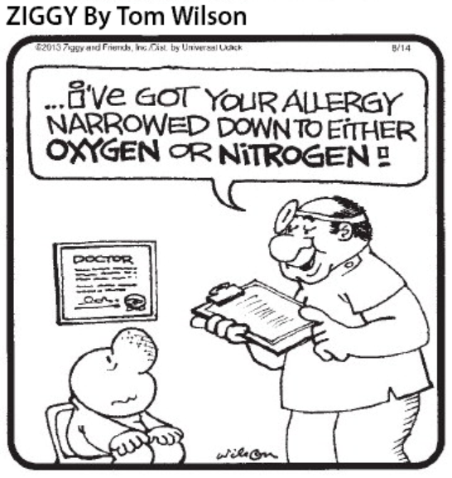
MCAS: Presentation
Constitutional
  Fever, chills, fatigue, sweats, weight ↑ or ↓ or ↑↓, pruritus
  Odd and prolific sensitivities (drugs, foods, environs)
Eyes
  Irritation, episodic inability to focus vision, blepharospasm
Ears
  Irritation, hearing deficit and/or tinnitus
Nose
  Irritation, sores, epistaxis, coryza
Oral/esophageal
  Irritation, sores, dysphagia, globus
Afrin LB, Butterfield JH, Martin R, Molderings GJ. Ann Med 2016;48(3):190-201.

Slide 37
MCAS: Presentation
Nodes
  Borderline pathologic, waxing/waning, migratory adenopathy
  Left upper quadrant (splenic?) discomfort common
  Path: usually reactive lymphocytosis, occ. sinus histiocytosis
Pulmonary
  Waxing/waning migratory edema/inflammation (e.g., cough)
  Dyspnea (normal PFTs; “I just can’t catch a deep breath”)
Cardiovascular
  Unprovoked presyncope/syncope, labile BP/pulse, palpitations
  Chest pain: coronaries usually clean, but occ. aggressive CAD
  Arterial, venous malformations; episodic migratory edema
  Takotsubo (acute balloon CHF), Kounis (allergic angina) synd.
Afrin LB, Butterfield JH, Martin R, Molderings GJ. Ann Med 2016;48(3):190-201.

Slide 38
MCAS: Presentation
GI
  Inflammation (any/all luminal segments, solid organs)
  Refractory GERD, IBS, mild ↑LFTs common
  Diarrhea  constipation
  Queasiness, nausea, vomiting (sometimes “cyclical”)
  Malabsorption common (gen., or selected micronutrients)
  Hepatic involvement common, usually inflamm./fibrosis
GU
  Inflammation (any/all luminal segments, solid organs)
    e.g., “interstitial cystitis”
  ↓ libido, infertility
Afrin LB, Butterfield JH, Martin R, Molderings GJ. Ann Med 2016;48(3):190-201.

Slide 39
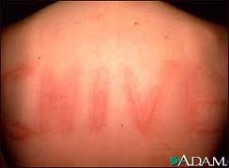

MCAS: Presentation
Musculoskeletal and Joints
  Myositis, osteopenia and/or osteosclerosis
  Diffusely migratory soft tissue pain; “fibromyalgia,” “CRPS”
    NSAIDs/narcotics often unhelpful (may trigger flares!)
Skin/Integument
  Lesions (many types), rashes (many types, often migratory), pruritus, flushing, angioedema, dermatographism
  Hair/nail/dental dystrophy
CNS
  Headache, vertigo, syncope, tic/tremor, weakness, dysautonomia
  Migratory paresthesias, insomnia very common
  Wide range of psychiatric disorders also found in MCAD
Afrin LB, Butterfield JH, Martin R, Molderings GJ. Ann Med 2016;48(3):190-201.

Slide 40
MCAS: Presentation
Heme
  Counts often normal, or…
    ↑ or ↓ H/H (subtle ↑ RDW, MCV, and/or MCH common)
    ↑ or ↓ WBC (subtle/intermit. ↑ monos, eos, &/or basos common)
    ↑ or ↓ plts
    ↑ or ↓ clotting
  Marrow
    Usually normal (histology, IHC, cytogenetics, flow, PCR)
    Most common abnormality: mild dysplasia (“unclass. MDS/MPN”)
Immunity
  Hypersensitivities, ↑ risk for malig., autoimm., infection
  Poor healing
Afrin LB, Butterfield JH, Martin R, Molderings GJ. Ann Med 2016;48(3):190-201.

Slide 41
MCAS: Presentation
Endocrinologic/metabolic
  Delayed puberty/menarche, dysmenorrhea
  Osteopenia/osteoporosis, osteosclerosis
  Hypo/hyperthyroidism, hyperferritinemia (inflammatory)
  ↑ or ↓ electrolytes, ↑ lipids (often hypertriglyceridemia)
Growth/Development
  Poor healing
  Cysts, fibrosis, endometriosis, vascular anomalies, cancer
  Connective tissue weakness (e.g., hypermobile Ehlers Danlos Syndrome)?
  Autism spectrum disorders?
Afrin LB, Butterfield JH, Raithel M, Molderings GJ. Ann Med 2016;48(3):190-201.

Slide 42

MCAS: Diagnosis
Best diagnostic aids:
  Most physicians’ best friend: a complete history and exam
  Faith in Occam’s Razor: which scenario is more likely?
    Multiple diagnoses/problems all independent of each other
    vs.
    One diagnosis that’s biologically capable of causing most or all of the findings (i.e., the simplest solution, even if it’s not the most immediately obvious solution)

Slide 43
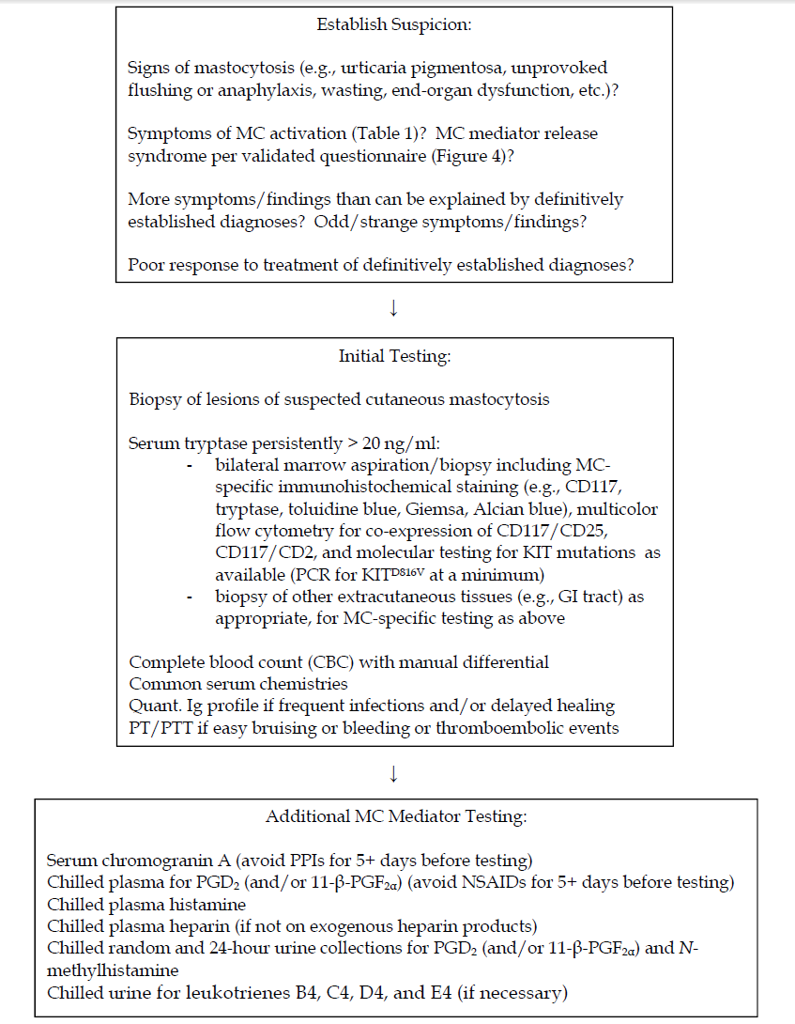
MCAS
Diagnostic
Work-Up:
2019
Afrin LB, Molderings GJ. A concise, practical guide to diagnostic assessment for mast cell activation disease. World J Hematol 2014 Mar;3(1):1-17.

Slide 44
MCAS: Diagnostic Lab Issues
Great thermolability of many mast cell mediators
  Half-lives at room temp. or higher as short as 30 seconds
    Heparin: 30-60 sec.
    Prostaglandin D2: 1-30 min.
    2,3-dinor-11-beta-prostaglandin-F2-alpha half-life: 1-30 min.
    Histamine in vivo: ~1-2 minutes (sep. plasma: 48 hrs.)
    N-methylhistamine: ~1-2 hrs.
    Tryptase in vivo: 6-8 min. (sep. serum: ~4 days)
  Continuous chilling ESSENTIAL!!!
    Collection into pre-chilled tubes/containers
    Immediate placement of specimens on ice
    Refrigerated centrifugation ESSENTIAL!!!
    Careful packing for transport to reference labs ESSENTIAL!!!
Afrin L. Presentation, Diagnosis, and Management of Mast Cell Activation Syndrome. In Mast Cells: Phenotypic Features, Biological Functions, and Role in Immunity, Nova Science Publishers, Happauge, NY, 2013, pp. 155-231.
Zenker N, Afrin LB. Utilities of various mast cell mediators in diagnosing mast cell activation syndrome. Blood 2015;126:5174.

Slide 45
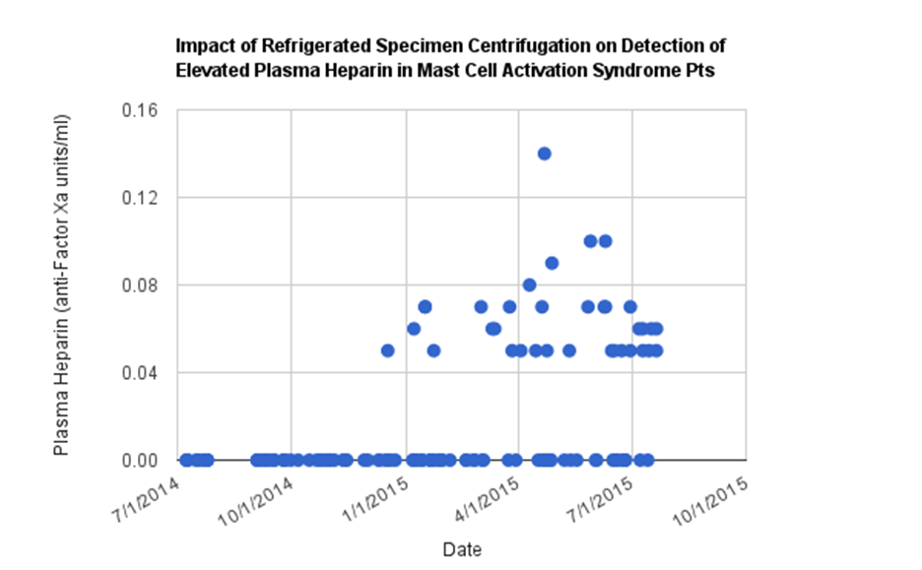
MCAS: Diagnostic Lab Issues
Mast cell mediator thermolability: heparin
Unrefrigerated centrifugation (UCF)
Refrig. cent. (RCF)
UCF
RCF
Zenker N, Afrin LB. Utilities of various mast cell mediators in diagnosing mast cell activation syndrome. Blood 2015;126:5174.

Slide 46
MCAS: Diagnostic Lab Issues
Again, most MCAS patients have the disease driven by somatic mutations in the dysfunctional mast cells…
…but a few MCAS patients have mast-cell-activating autoantibodies…
  …and it’s therapeutically important to identify these autoantibodies, as such patients essentially have an autoimmune (rather than mutational) form of MCAS and may respond well to immunosuppressive therapies which otherwise would not be considered until late in the course, if ever, in treating mutationally driven MCAS

Slide 47
MCAS: Diagnostic Lab Issues
Mast-cell-activating antibodies:
  Anti-IgE antibodies (do not confuse with an IgE level!)
    Qualitative assays (“elevated” vs. “normal,” e.g., Viracor) insufficient
    Quantitative assays (e.g., Quest) needed to adequately assess likelihood that an elevated level is clinically significant
      MCAS commonly drives the humoral immune system to spuriously produce antibodies, and many (most?) of the specific antibodies found in MCAS patients are mimicking antibodies
      Phenomenon of mimicking antibodies long recognized (e.g., insufficiently specific anti-H. pylori antibodies also targeting platelets and driving immune thrombocytopenic purpura)
      Certain titer patterns (thus the importance of quantitative assays) help distinguish pathogenic autoantibodies (or real infectious-disease-reflecting alloantibodies) from mimicking antibodies
      No point ordering anti-IgE antibodies in a patient given omalizumab (a therapeutic monoclonal anti-IgE antibody) in the last year
  Anti-IgE-receptor antibodies
    a.k.a. chronic urticaria (CU) index
    a.k.a. histamine release assay
    a.k.a. basophil activation assay

Slide 48
MCAS: Diagnostic Lab Issues
Why is repeat testing (following failed initial testing) sometimes needed?
  Logistical issues:
    Chilling issues (e.g., collection in non-prechilled containers, failure to immediately immerse specimens in ice, use of a “normal,” unrefrigerated centrifuge, etc.)
    Shipment delays
  Biological issues:
    Mast cells produce/release >200 mediators, with blood/urine levels of any given (typically short-half-life!) mediator constantly in flux.
      Only a minority are presently measurable in the clinical laboratory.
      Only a minority of that minority are relatively specific to the mast cell.
    Clearly, what we are measuring is a very poor surrogate for the totality of the signaling chaos in this disease.
    Therefore, the mediators we’re measuring are not necessarily (and, for most of the disease’s symptoms, if you play the odds, probably aren’t) the mediators producing the symptoms.
    And, obviously, if we “miss it” with the first round of testing, that doesn’t even begin to invalidate/refute/negate even a single element of the patient’s history which typically has been shouting “MCAS!” for decades; instead, the challenges of testing need to be acknowledged and repeat testing needs to be pursued.
    Almost all patients whose clinical courses suggest MCAS find diagnostic laboratory evidence within 3 rounds of non-invasive (blood/urine) testing.

Slide 49
MCAS: Diagnostic Lab Issues
Increased numbers of mast cells in extracutaneous tissue (and not in patterns reflecting mastocytosis (e.g., spindling, aggregation)) also accepted as laboratory evidence by the “alternative” criteria
  No “gold standard” studies yet defining threshold between normal vs. abnormal mast cell counts in any tissue
  All available studies have significant flaws, mostly with regard to selection of healthy/normal controls
  At present, in my dialogue about this issue with >100 pathologists around the world in the last decade, most feel >20 mast cells per high-power (400x) field is a reasonable threshold in the gastrointestinal and genitourinary tracts
  Why not pursue this (invasive!) testing in more patients?
    It’s invasive! (i.e., likely riskier, more expensive than non-invasive testing)
    We do pursue re-staining for mast cells in old tissues still available
    We do pursue this in patients in whom non-invasive testing repeatedly fails
Molderings G, et al. Mast cell activation disease: a concise practical guide for diagnostic workup and therapeutic options. J Hematol Oncol 2011;4:10.
Afrin LB, et al. Often seen, rarely recognized: mast cell activation disease – a guide to diagnosis and therapeutic options. Ann Med 2016;48(3):190-201.
Molderings GJ et al. F1000Res. 2017 Oct 26;6:1889. doi: 10.12688/f1000research.12730.1.
Jakate S, et al., Mastocytic enterocolitis: increased mucosal mast cells in chronic intractable diarrhea. Arch Pathol Lab Med 2006 Mar;130(3):362-7.

Slide 50
MCAS: Prognosis
No epidemiologic studies of prognosis yet
Present gestalt impression:
  After the first three years, survival curves parallel the general population (similar to indolent systemic mastocytosis (ISM))
So, like allergic diseases and ISM, reduced survival is a relatively small problem in MCAS, and instead most suffer reduced quality of life (anywhere from mild to severe, variable over time) until the disease is accurately diagnosed and effectively controlled
Many therapies (targeting many receptors and pathways) found helpful in various MCAD/MCAS patients
  Most cytotoxic chemotherapy quite unlikely to help MCAS
Most MCAS pts eventually identify a significantly helpful regimen…
  …and given they’ll likely live a normal lifespan, the improved quality of life they can achieve – once correctly diagnosed – is important!
Roberts LJ, Anthony LB, Oates JA. “Disorders of Vasodilator Hormones: Carcinoid Syndrome and Mastocytosis” in Wilson JD, Foster DW, Kronenberg HM, et al., eds., Williams Textbook of Endocrinology, 9th ed., 1998, W. B. Saunders Company, Philadelphia, pp. 1718-1732.
Lim K-H, et al. Systemic mastocytosis in 342 consecutive adults: survival studies and prognostic factors. Blood 2009;113:5727-5736.

Slide 51
MCAS: Treatment
2019: Largely as for indolent mastocytosis
  Identify and avoid triggers
  Inhibit mediator production
  Inhibit mediator release
  Block actions of released mediators
  Cytotoxic and cellular therapy only for aggressive SM, MCL
  Secondary issues and comorbidities

Slide 52
MCAS: Treatment
2019: Largely as for indolent mastocytosis
  Identify and avoid triggers, both antigenic (environmental, dietary, medication, etc.) and physical
    Or try desensitization therapy if feasible
    Be aware: medication excipients often are prominent triggers
      Trying alternative (commercial or compounded) formulations often necessary
    Low-histamine diets, diamine oxidase supplementation
  Inhibit mediator production
  Inhibit mediator release
  Block actions of released mediators
  Cytotoxic and cellular therapy only for aggressive SM, MCL
  Secondary issues and comorbidities

Slide 53
MCAS: Treatment
2019: Largely as for indolent mastocytosis
  Identify and avoid triggers
  Inhibition of mediator production
    Steroids (long-term issues), NSAIDs (pharmacologic or “natural”)
    Vitamin C
    Flavonoids
    Possibly also hydroxyurea (or even IMiDs?)
  Inhibition of mediator release (stabilization)
  Blockade of released mediators
  Rarely (if ever): Cytotoxic therapy
  Hypothetical: Cellular therapy
  Secondary issues and comorbidities

Slide 54
MCAS: Treatment
2019: Largely as for indolent mastocytosis
  Identify and avoid triggers
  Inhibition of mediator production
  Inhibition of mediator release (stabilization)
    Cromolyn (oral and/or inhaled – non-absorbed)
      Can trigger flares 1st few days; tachyphylaxis can abrogate efficacy
    Pentosan (especially for interstitial cystitis)
    Tyrosine kinase inhibitors
    Interferon (& pegylated form?)
    Omalizumab (anti-IgE)
    Azathioprine, other immunosupp.
    JAK and mTOR inhibitors?
    Benzodiazepines and imidazopyridines; cannabinoids; naltrexone
      e.g., lorazepam, clonazepam, flunitrazepam, zolpidem; cannabidiol
  Blockade of released mediators
  Rarely (if ever): Cytotoxic therapy
  Hypothetical: Cellular therapy
  Secondary issues and comorbidities
Imatinib (FDA approved for CML, mastocytosis)
Dasatinib (FDA approved for CML)
Nilotinib (FDA approved for CML)
Sunitinib (FDA approved for renal cell Ca & GIST)
Midostaurin (FDA approved in AML, ASM/MCL)?
Masitinib, avapritinib (investigational)?
Molderings GJ et al. Pharmacological treatment options for mast cell activation disease. Naunyn Schmiedebergs Arch Pharmacol 2016 Jul;389(7):671-94.

Slide 55
MCAS: Treatment
2019: Largely as for indolent mastocytosis
  Identify and avoid triggers
  Inhibition of mediator production
  Inhibition of mediator release (stabilization)
  Blockade of released mediators
    Antihistamines (even cont. IV diphenhydramine in severely afflicted pts)
      Often impressive benefits even absent rhinosinusitis and dyspepsia
      Can also stabilize mast cells via their autoexcitatory H₁/H₂ receptors
    Leukotriene antagonists
    Calcium/vit. D, bisphosphonates, denosumab for osteoporosis/osteopenia
    TNF antagonists (etanercept, adalimumab, infliximab)?
    IL-1 antagonists (e.g., anakinra), IL-1β antagonists (e.g., canakinumab)?
    In development: inhibitors of tryptase, chymase, H₃ receptors, etc. etc.
  Rarely (if ever): Cytotoxic therapy
  Hypothetical: Cellular therapy
  Secondary issues and comorbidities

Slide 56
MCAS: Treatment
2019: Largely as for indolent mastocytosis
  Identify and avoid triggers
  Inhibition of mediator production
  Inhibition of mediator release (stabilization)
  Blockade of released mediators
  Rarely (if ever): Cytotoxic therapy
    Hydroxyurea, alkylators, taxanes, etc.
    Fludarabine, cladribine, cytarabine, etc.
    Alemtuzumab, daclizumab
  Hypothetical: Cellular therapy
  Secondary issues and comorbidities

Slide 57
MCAS: Treatment
2019: Largely as for indolent mastocytosis
  Identify and avoid triggers
  Inhibition of mediator production
  Inhibition of mediator release (stabilization)
  Blockade of released mediators
  Rarely (if ever): Cytotoxic therapy
  Hypothetical: Cellular therapy
    Allogeneic stem cell transplantation
      Likely to be extremely challenging
  Secondary issues and comorbidities

Slide 58
MCAS: Treatment
2019: Largely as for indolent mastocytosis
  Inhibition of mediator production
  Inhibition of mediator release (stabilization)
  Blockade of released mediators
  Rarely (if ever): Cytotoxic therapy
  Hypothetical: Cellular therapy
  Treatment of secondary issues and comorbidities
    Frequent mistake by patients and providers: Assuming a symptom (new or old, chronic or acute) is directly due to MCAS
      MCAS does not render one immune to developing other disease
      Regardless of the likelihood that a symptom may ultimately stem from MCAS, rule out other reasonable diagnostic considerations before assuming MCAS is the (direct) cause!
    Illnesses secondary to mast cell disease require full treatment until the mast cell disease is controlled, and even then…
    “…the horse is sometimes already out of the barn”: malignancy and autoimmunity rarely, if ever, spontaneously remit simply with control of the underlying mast cell disease

Slide 59
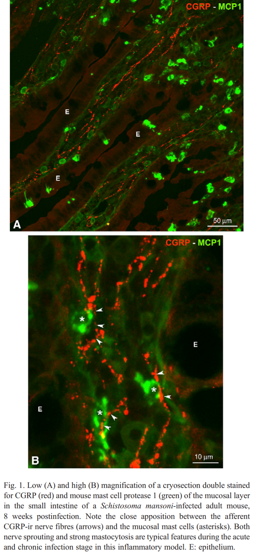
MCAS: Treatment
Non-pharmacologic therapies occasionally can be helpful, too
  For example, certain behavioral re-training programs
  Typically require longer periods (3-6 months) to see improvement than required by most pharmacological interventions
  Mechanisms unclear, but seems likely related to the known close interactions – even physical abutment! – of neurons and mast cells throughout the body, with constant mediator “cross-talk” between such dyads
Shown with permission from ref. 6 below.
1. Blennerhassett MG et al. Cell Tissue Res 1991 Jul;265(1):121-8.
2. Theoharides TC et al. Trends Pharmacol Sci 2004 Nov;25(11):563-8.
3. Theoharides TC. Life Sci 1990;46(9):607-17.
4. Barbara G et al. Gastroenterology 2007 Jan;132(1):26-37.
5. Newson B et al. Neuroscience 1983 Oct;10(2):565-7,569-70.
6. Van Nassauw L et al. Autonom Neurosci 2007 Apr 30;133(1):91-103.

Slide 60
MCAS: Key Nursing Care Issues
Patient-Professional Trust Issues
  An MCAS patient’s distrust of health care professionals (MDs, RNs, etc.) is born out of years of:
    Professionals not listening to patient’s complaints
    Professionals denying/dismissing/mocking patient’s complaints
    Misdiagnoses of psychosomatism & Munchausen’s (& by proxy) despite careful case review showing such just isn’t possible
      Note neuropsychiatric issues (most common psych issues: anxiety, depression) are COMMON in MCAS but almost always are SECONDARY to the MCAS
    Repeated failure to think of, and establish, convincing/unifying diagnoses
    Repeated failure to find significant/explanatory abnormalities in tests
    Repeated failure of empirically tried treatments to provide significant benefit
    Repeated failure to identify sensible directions for further investigation

Slide 61
MCAS: Key Nursing Care Issues
MCAS patients often have remarkable sensitivities/ reactivities to:
  Substances
    Foods
    Odors/fragrances
      MCAS patients CAN smell, and react to, food odors in the nurses’ lounge at the opposite end of the ward
    Chemicals (detergents, soaps, petroleum-based products…), whether natural or artificial, whether liquid or solid or aerosolized
    Environmental exposures: pollens, molds, animal danders, etc.
    Medication products (ESPECIALLY EXCIPIENT INGREDIENTS!)
      When an MCAS patient tells you he/she can only tolerate certain formulations of a drug, he/she is not kidding!
        Intolerable formulation = risk for anaphylaxis or other serious rxns
      These are the patients with the “impossible” reactivities, i.e., reactivities to medications “everybody” tolerates, reactivities to “inert” implanted materials, apparent reactivities to saline

Slide 62
MCAS: Key Nursing Care Issues
MCAS patients often have remarkable sensitivities/ reactivities to:
  Activities
    MCAS is highly associated with chronic fatigue syndrome (CFS)
      Poor stamina, unusual post-exertional fatigue
    MCAS is highly associated with postural orthostatic tachycardia syndrome (POTS)
      Poor tolerance of orthostatic changes
      Significant lability of BP and/or pulse is COMMON
    MCAS is highly associated with hypermobile Ehlers Danlos Syndrome (hEDS)
      Diffuse pain; sometimes trivially easy joint dislocations
    MCAS patients often easily bruise/bleed from trivial triggers
      Aberrant heparin release by dysfunctional mast cells in a particular site + very short half-life of heparin at body temperature = significant LOCAL bleeding with no detectable significant SYSTEMIC coagulopathy

Slide 63
MCAS: Key Nursing Care Issues
MCAS patients often have remarkable sensitivities/ reactivities to:
  Physical forces
    Changes in TEMPERATURE (note, too, their frequent dysautonomias include frequent poor temp./sweat regulation)
    Changes in PRESSURE (sometimes as subtle as changes in air pressure, such as with an approaching storm)
    Loud noises (misophonia)
    Low wavelengths (bass tones, vibrations)
    High wavelengths (high audio tones, ultraviolet (e.g., from not only sun but also fluorescent lights!), radio (WiFi!), gamma (radiotherapy))
    Electric shocks (static electricity exposures)
      Curiously, ECT usually is well tolerated, possibly due to mast-cell-stabilizing pre-medications

Slide 64
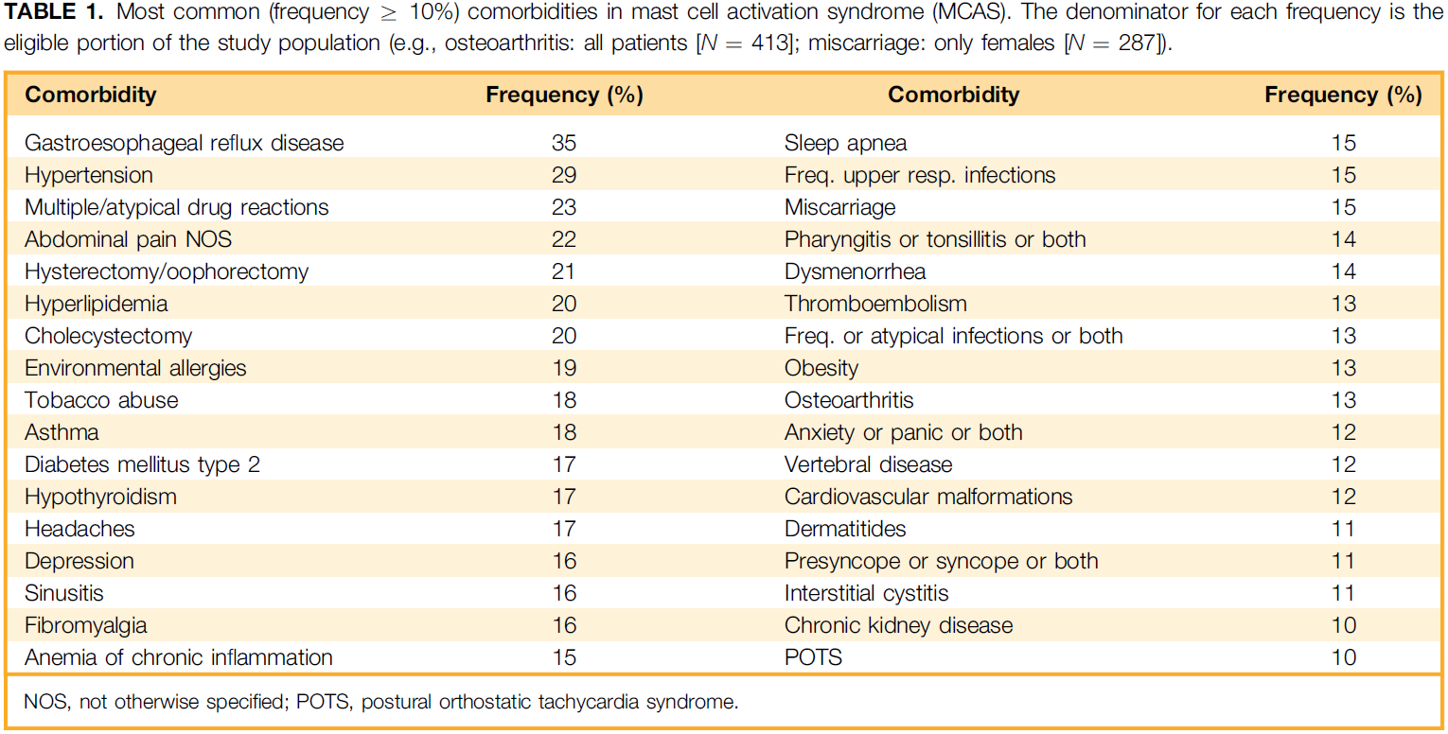
Characterization of MCAS
Afrin LB, Self S, Menk J, Lazarchick J. Am J Med Sci 2017;353(3):207-215.

Slide 65
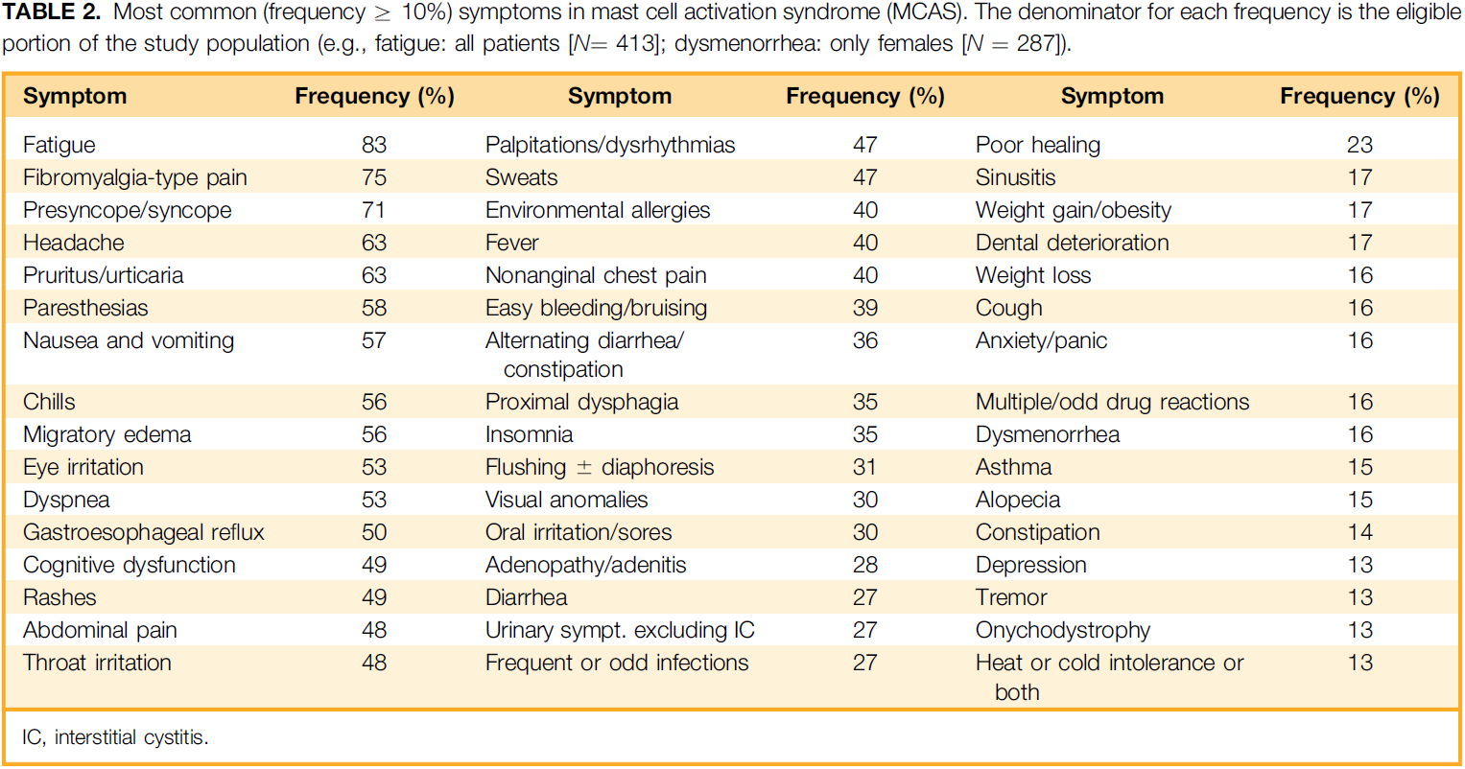
Characterization of MCAS
Afrin LB, Self S, Menk J, Lazarchick J. Am J Med Sci 2017;353(3):207-215.

Slide 66
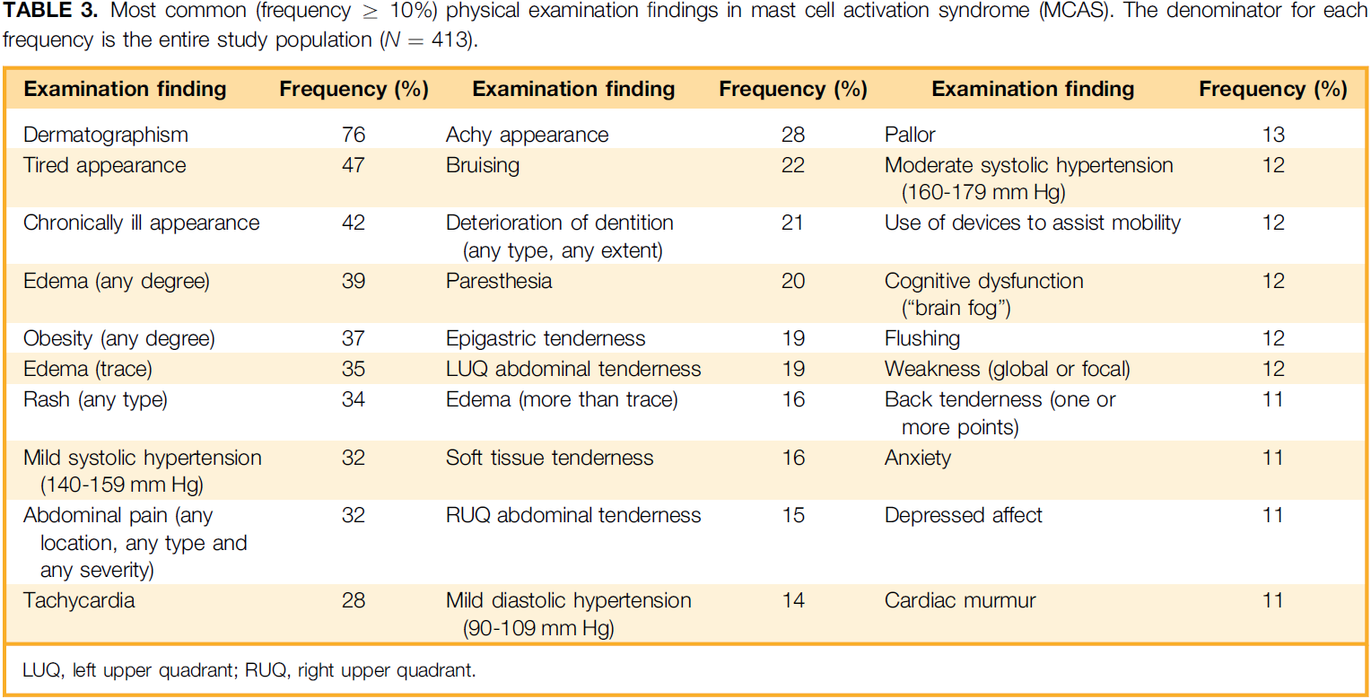
Characterization of MCAS
Afrin LB, Self S, Menk J, Lazarchick J. Am J Med Sci 2017;353(3):207-215.

Slide 67
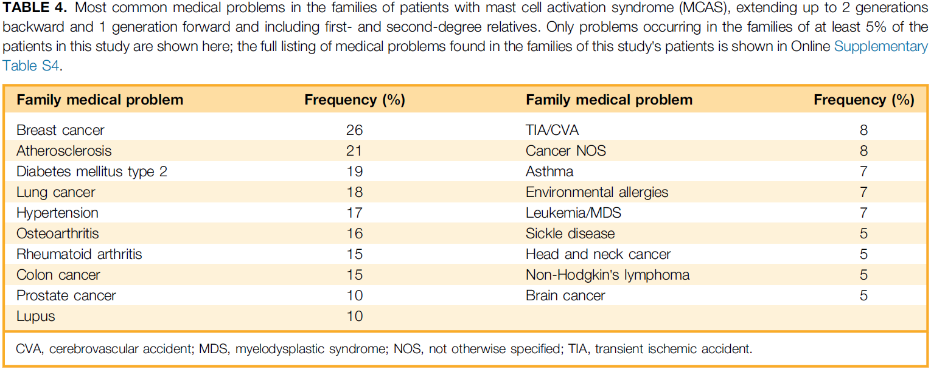
Characterization of MCAS
Afrin LB, Self S, Menk J, Lazarchick J. Am J Med Sci 2017;353(3):207-215.

Slide 68
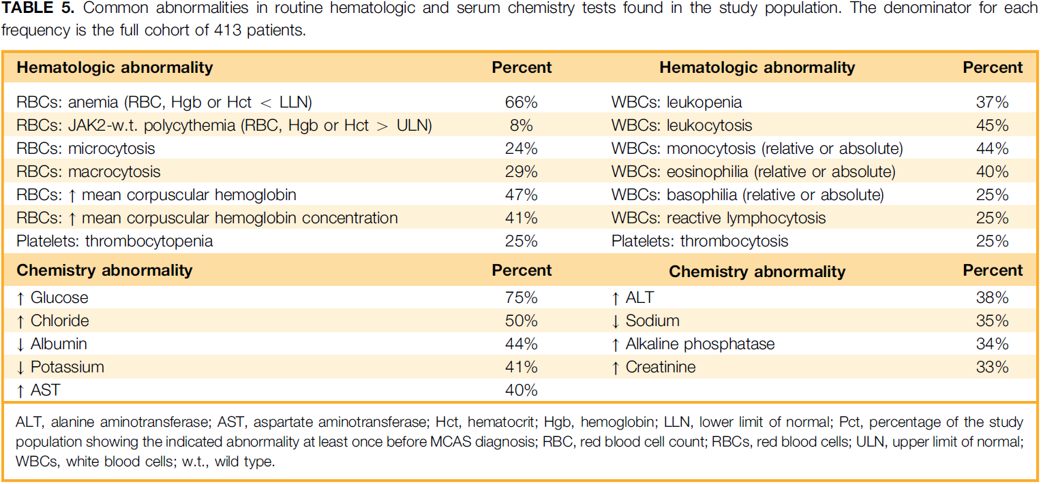
Characterization of MCAS
Afrin LB, Self S, Menk J, Lazarchick J. Am J Med Sci 2017;353(3):207-215.

Slide 69
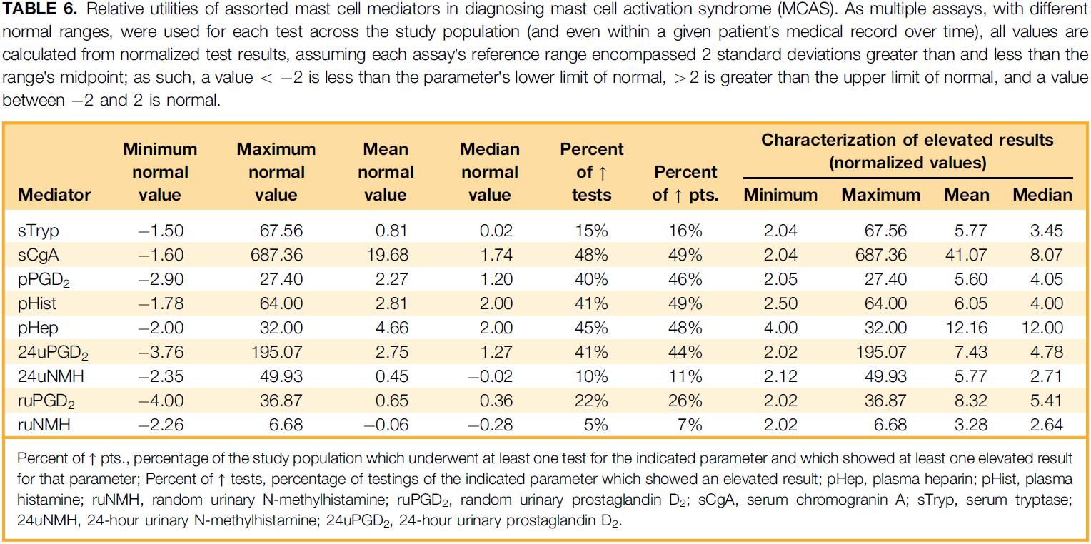
Characterization of MCAS
Afrin LB, Self S, Menk J, Lazarchick J. Am J Med Sci 2017;353(3):207-215.

Slide 70
MCAD: Other Research Ideas
Characterization of Mast Cell Regulatory Gene Mutations in MCAS
MCAD in Refractory GERD
MCAD in Asthma
MCAD in Obesity
MCAD in Fibromyalgia
MCAD in Chronic Fatigue Syndrome
MCAD in Irritable Bowel Syndrome
MCAD in Hypermobile Ehlers-Danlos Syndrome
MCAD in Postural Orthostatic Tachycardia Syndrome
MCAD in Atherosclerotic Vascular Disease
MCAD in Multiple Chemical Sensitivity (MCS)/Toxicant-Induced Loss of Tolerance (TILT)
MCAD in Gulf War Illness
MCAD as a Significant Modifier in Sickle Cell Disease
Etc. etc. etc. etc.

Slide 71
MCAD: What’s next?
RESEARCH
  Improved diagnostic techniques
    Early genomic sequencing of isolated mast cells to distinguish primary from secondary disease and identify mutational patterns correlating with various clinical presentations?
  Etiology
    Environmental? Genetic? Epigenetic? Viral?
  Therapy
    Predictive biomarkers
    Targeted therapies
EDUCATION (providers, payers, patients, grantors)

Slide 72


Summary
MCAD Diagnostic Class | General Prevalence | Phenotype | Tryptase usually…
Allergic Diseases | Prevalent | Allergy ± Inflammation | Normal
Mastocytosis | Rare | MC Neoplasia ± Inflamm./Allergy | Elevated
MCAS | Prevalent | Inflamm. ± Allergy ± Dystrophism | Normal
Tryptase dominantly reflects total body MC load, not activation state
MCAD symptoms usually from MC activation, not load
Most MCAD patients…
  …have normal survival, making disease control even more important (QoL!)
  …can eventually find significantly helpful therapy once diagnosed
Challenges:
  Heterogeneity of MCAS (mutational origin?)
  Many helpful therapies already found, but no
  biomarkers yet identified which reliably predict
  helpful therapy
  Education of patients, providers, payers, regulators,
  grantors, pharma, etc. etc. etc.
Questions later?
drafrin@
armonkmed.com
Questions?

